Slide 1
Continuous Integration

Slide 2
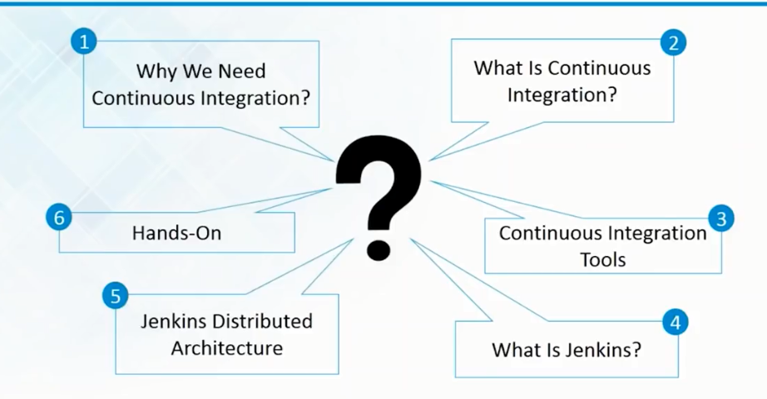

Slide 3
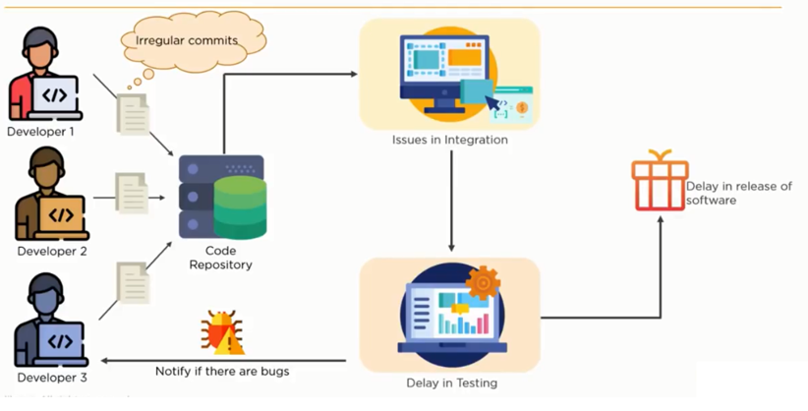
Problems before continuous integration

Slide 4
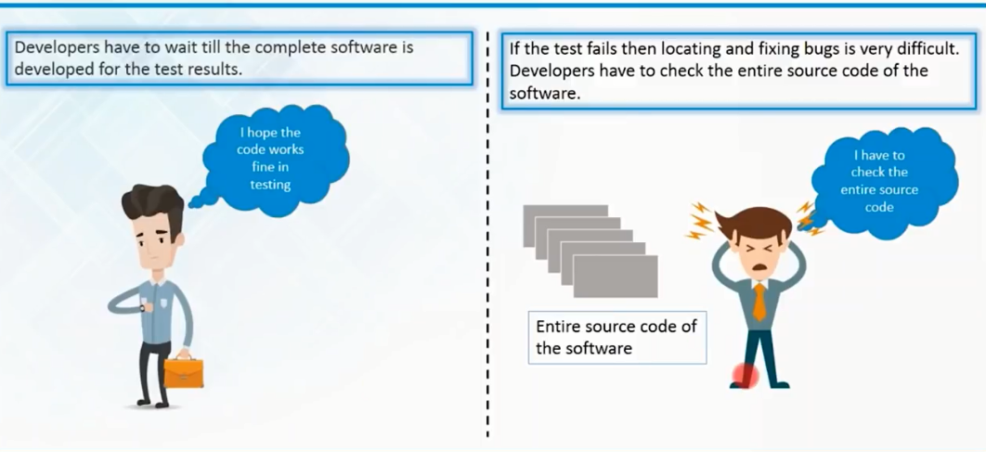
Problems before continuous integration

Slide 5
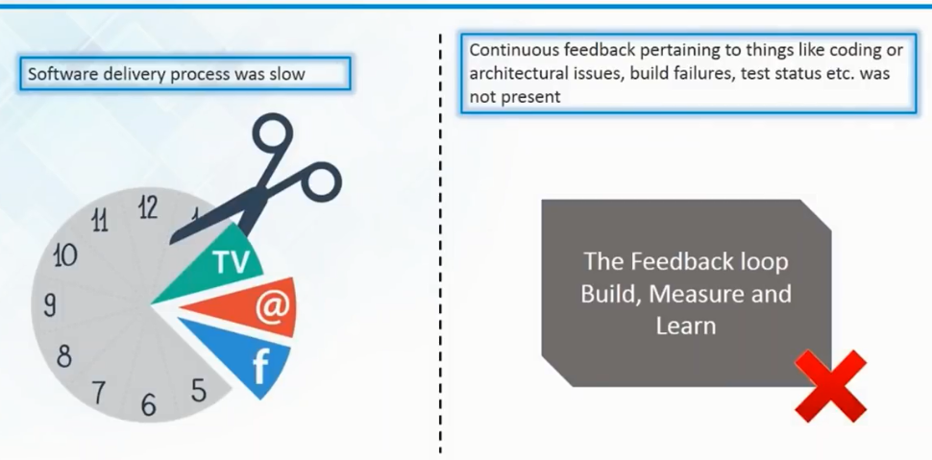
Problems before continuous integration

Slide 6
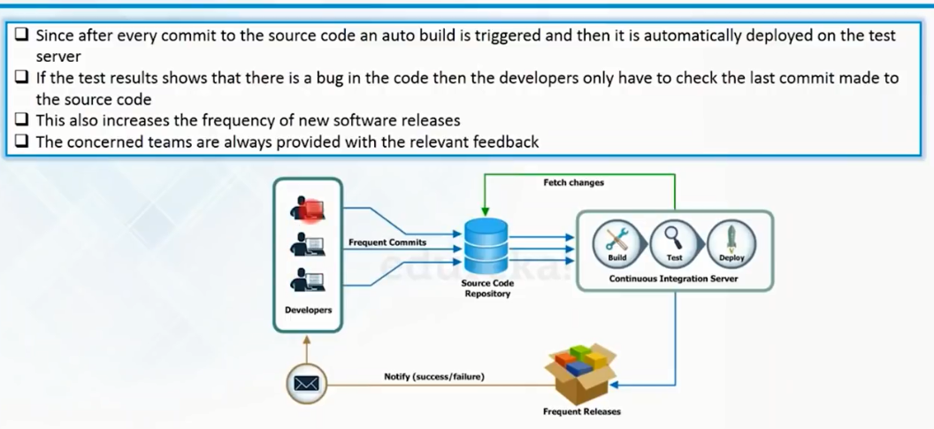
Continuous integration to the rescue

Slide 7
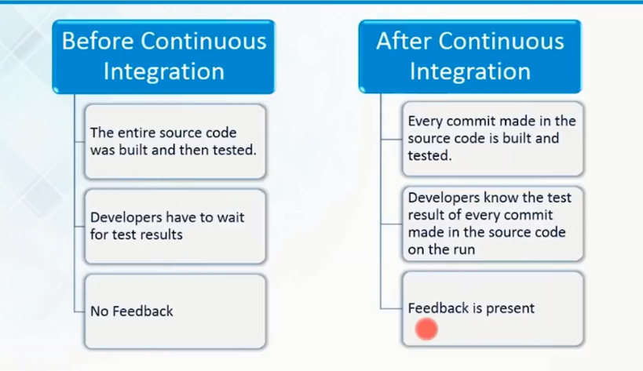
Continuous integration to the rescue

Slide 8
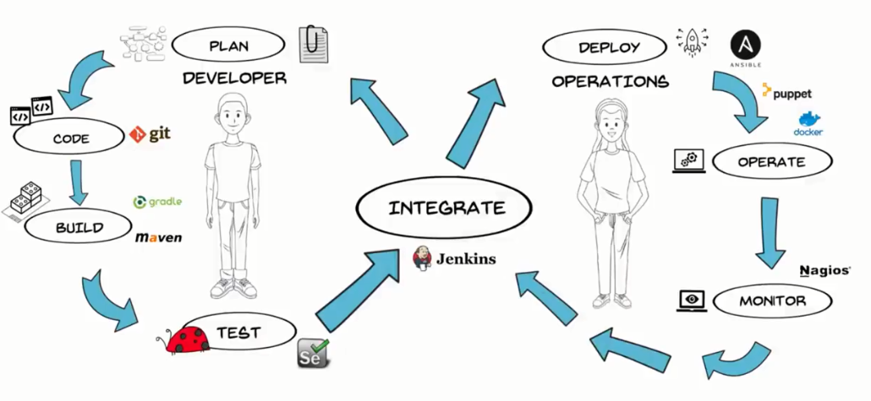
What is Continuous integration?

Slide 9
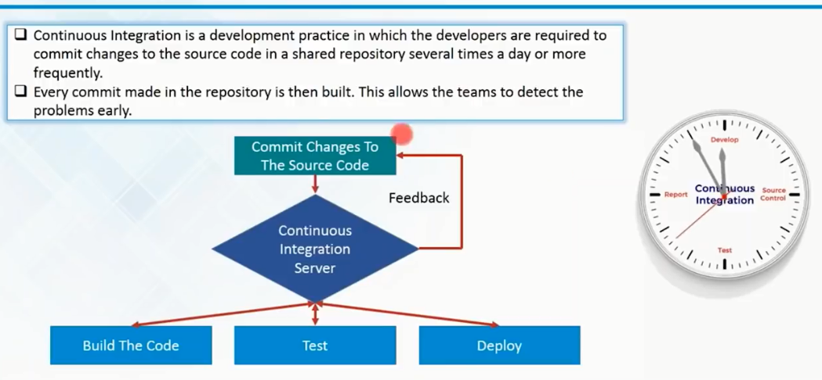
What is Continuous integration?

Slide 10
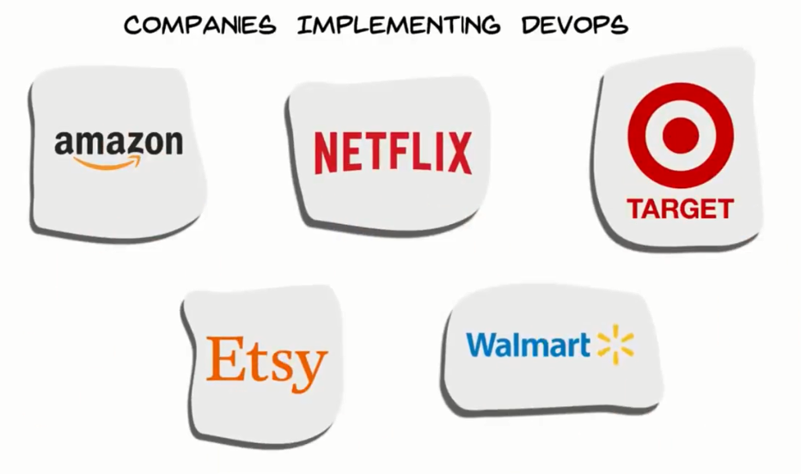

Slide 11
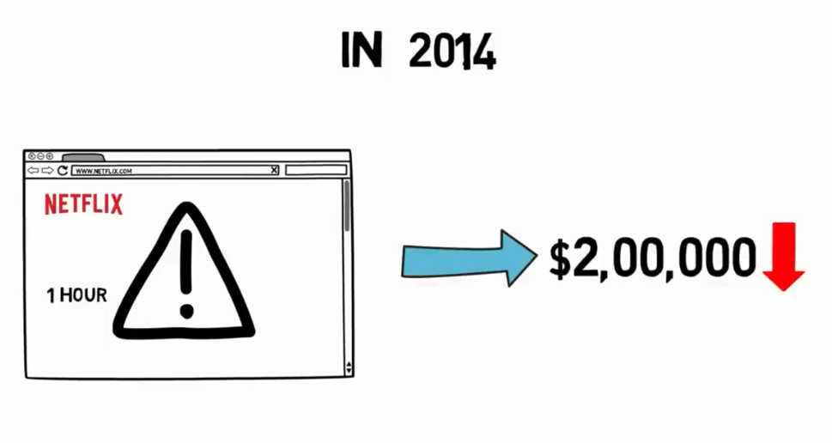

Slide 12
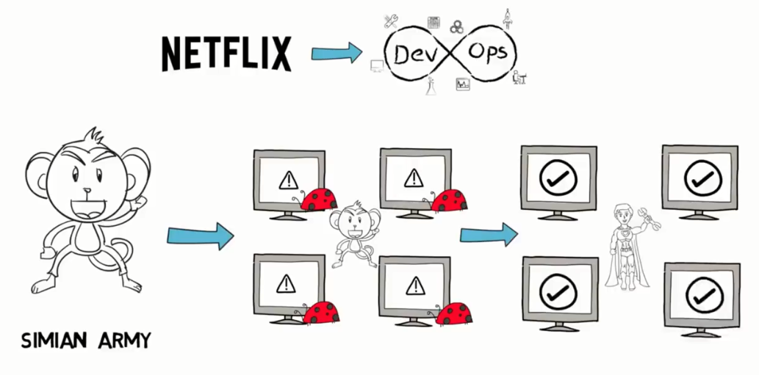

Slide 13
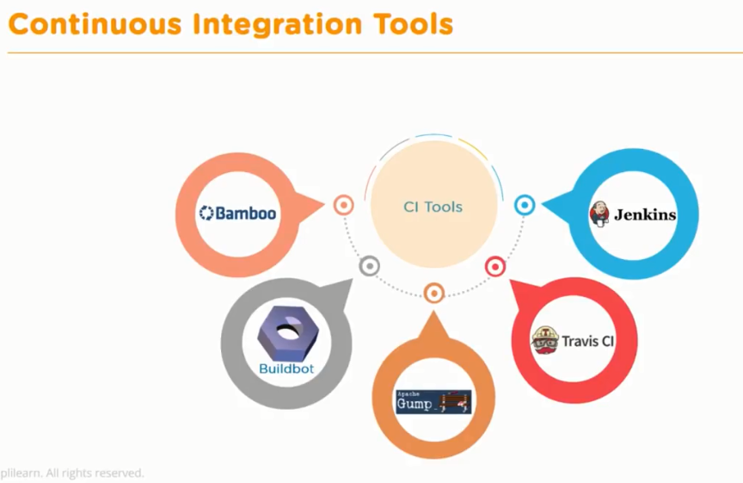

Slide 14
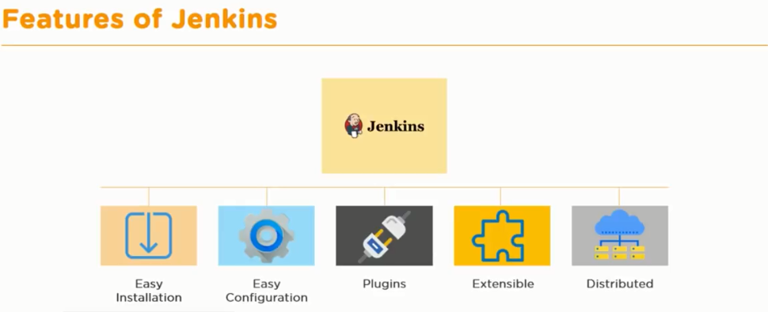

Slide 15
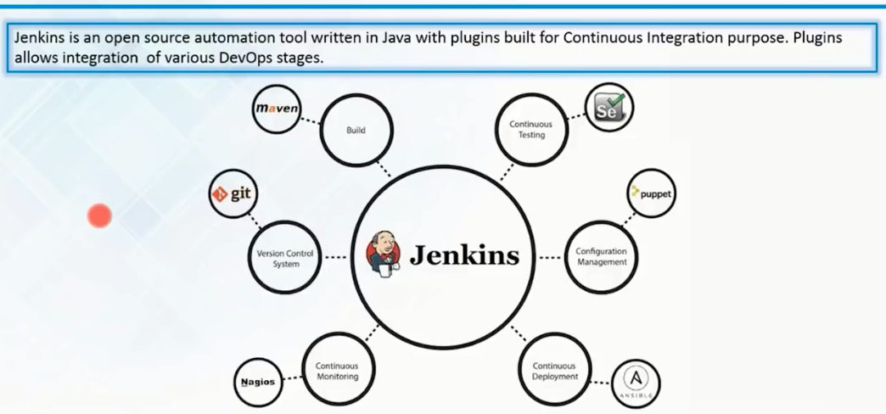
What is Jenkins?

Slide 16
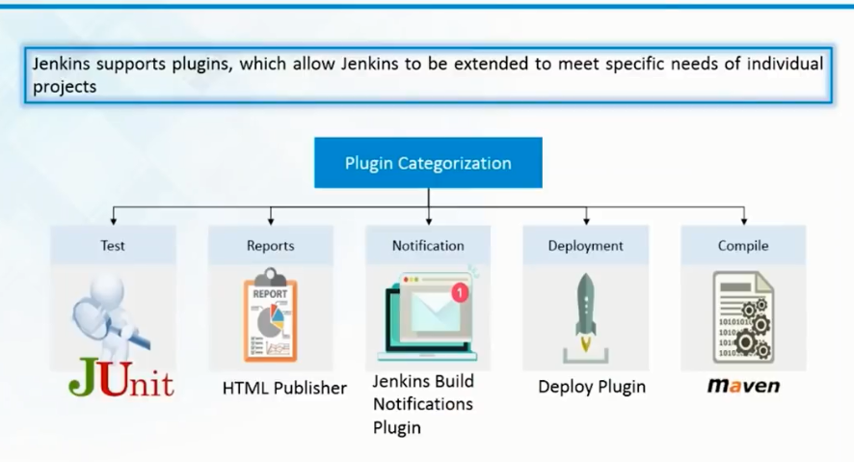
Jenkins Plugins Categorization

Slide 17
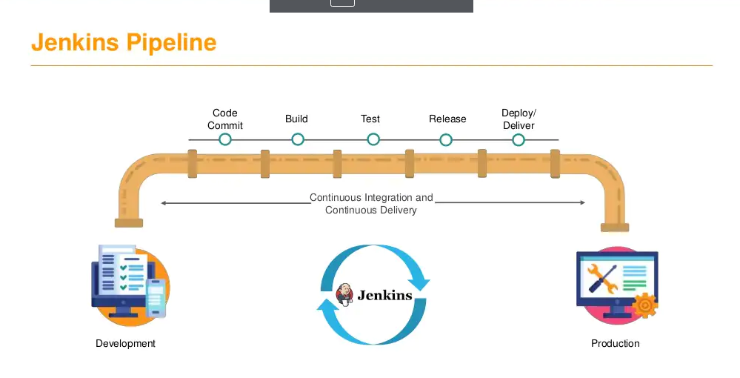

Slide 18
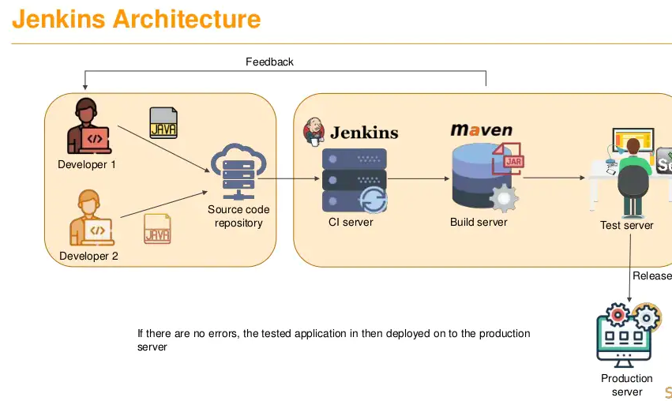

Slide 19
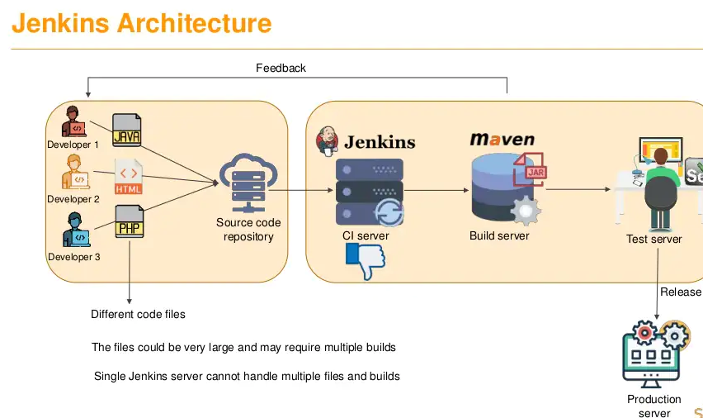
We need to have distributed Jenkins architecture to overcome such issues

Slide 20
What is CI/CD?
CI/CD is a method to frequently deliver apps to customers by introducing automation into the stages of app development. The main concepts attributed to CI/CD are continuous integration, continuous delivery, and continuous deployment. CI/CD is a solution to the problems integrating new code can cause for development and operations teams (AKA "integration hell").
Specifically, CI/CD introduces ongoing automation and continuous monitoring throughout the lifecycle of apps, from integration and testing phases to delivery and deployment. Taken together, these connected practices are often referred to as a "CI/CD pipeline" and are supported by development and operations teams working together in an agile way with either a DevOps or site reliability engineering (SRE) approach.

Slide 21
What's the difference between CI and CD (and the other CD)?
The "CI" in CI/CD always refers to continuous integration, which is an automation process for developers. Successful CI means new code changes to an app are regularly built, tested, and merged to a shared repository. It’s a solution to the problem of having too many branches of an app in development at once that might conflict with each other.
The "CD" in CI/CD refers to continuous delivery and/or continuous deployment, which are related concepts that sometimes get used interchangeably. Both are about automating further stages of the pipeline, but they’re sometimes used separately to illustrate just how much automation is happening.

Slide 22
What's the difference between CI and CD (and the other CD)?
Continuous delivery usually means a developer’s changes to an application are automatically bug tested and uploaded to a repository (like GitHub or a container registry), where they can then be deployed to a live production environment by the operations team. It’s an answer to the problem of poor visibility and communication between dev and business teams. To that end, the purpose of continuous delivery is to ensure that it takes minimal effort to deploy new code.
Continuous deployment (the other possible "CD") can refer to automatically releasing a developer’s changes from the repository to production, where it is usable by customers. It addresses the problem of overloading operations teams with manual processes that slow down app delivery. It builds on the benefits of continuous delivery by automating the next stage in the pipeline.

Slide 23
What is a CI/CD pipeline?
A CI/CD pipeline is a series of steps that must be performed in order to deliver a new version of software. Continuous integration/continuous delivery (CI/CD) pipelines are a practice focused on improving software delivery using either a DevOps or site reliability engineering (SRE) approach.
A CI/CD pipeline introduces monitoring and automation to improve the process of application development, particularly at the integration and testing phases, as well as during delivery and deployment. Although it is possible to manually execute each of the steps of a CI/CD pipeline, the true value of CI/CD pipelines is realized through automation.

Slide 24
Elements of a CI/CD pipeline
The steps that form a CI/CD pipeline are distinct subsets of tasks grouped into what is known as a pipeline stage. Typical pipeline stages include:
Build - The stage where the application is compiled.
Test - The stage where code is tested. Automation here can save both time and effort.
Release - The stage where the application is delivered to the repository.
Deploy - In this stage code is deployed to production.
Validation and compliance - The steps to validate a build are determined by the needs of your organization. Image security scanning tools, like Clair, can ensure the quality of images by comparing them to known vulnerabilities (CVEs).

Slide 25
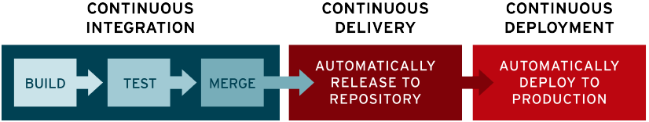

Slide 26
Installing Jenkins
Step 1: check if java is already installed (java 8 or java 11 is installed)
java –version.
If not…..
Step 2: download java
Java 8 runtime environments are supported in both 32-bit and 64-bit versions
Java 11 runtime environments are supported
http://www.java.com/download
Step 3: Run the java exe
Step 4: Setting environment variables
Step 5: check if java is installed and available

Slide 27
Installing Jenkins
Step 1: Check if Java is installed.
Step 2: Download Jenkins.war file (https://www.jenkins.io/)
Step 3: Goto cmd prompt and run command
java –jar Jenkins.war
java –jar Jenkins.war –httpPort=ptno
Step 4: Copy the password
Step 5: Open browser and start Jenkins – http://localhost:8080
Step 6: Provide the password and complete the setup
UBUNTU
Step 1: Check if Java is installed (java –version) (sudo apt install openjdk-8-jdk).
Step 2: Follow the instructions
https://www.digitalocean.com/community/tutorials/how-to-install-jenkins-on-ubuntu-18-04
https://www.jenkins.io/doc/book/installing/linux/

Slide 28
How to use Command Line in Jenkins CLI
Step 1 : start Jenkins
Step 2 : goto Manage Jenkins - Configure Global Security - enable security
Step 3 : goto - http://localhost:8080/cli/
Step 4 : download jerkins-cli jar. Place at any location.
Step 5 : test the jenkins command line is working
java –jar jenkins-cli.jar –s http://localhost:8080 –auth usename:passsword
JOB : Name of the job to build
-c : Check for SCM changes before starting the build, and if there's no change, exit without doing a build
-f : Follow the build progress. Like -s only interrupts are not passed through to the build.
-p : Specify the build parameters in the key=value format.
-s : Wait until the completion/abortion of the command. Interrupts are passed through to the build.
-v : Prints out the console output of the build. Use with -s
-w : Wait until the start of the command

Slide 29
How to create Users + Manage + Assign Roles
Step 1 : Create new users
Step 2 : Configure users
Step 3 : Create and manage user roles Role Based Authorization Strategy Plugin - download - restart jenkins
Step 4 : Manage Jenkins - Configure Global Security - Authorization - Role Based Strategy
Step 5 : Create Roles and Assign roles to users
Step 6 : Validate authorization and authentication are working properly

Slide 30
What is Maven?
Maven is a popular open-source build tool developed by the Apache Group to build, publish, and deploy several projects at once for better project management. The tool provides allows developers to build and document the lifecycle framework.
Maven is written in Java and is used to build projects written in C#, Scala, Ruby, etc. Based on the Project Object Model (POM), this tool has made the lives of Java developers easier while developing reports, checks build and testing automation setups.

Slide 31
Building apps using MAVEN
Maven is based around the central concept of a build lifecycle. What this means is that the process for building and distributing a particular artifact (project) is clearly defined.
For the person building a project, this means that it is only necessary to learn a small set of commands to build any Maven project, and the POM will ensure they get the results they desired.
There are three built-in build lifecycles: default, clean and site. The default lifecycle handles your project deployment, the clean lifecycle handles project cleaning, while the site lifecycle handles the creation of your project's web site.

Slide 32
Building apps using MAVEN
Validate
validate - validate the project is correct and all necessary information is available
Compile
compile - compile the source code of the project
Test
test - test the compiled source code using a suitable unit testing framework. These tests should not require the code be packaged or deployed
Package
package - take the compiled code and package it in its distributable format, such as a JAR.
Verify
verify - run any checks on results of integration tests to ensure quality criteria are met
Install
install - install the package into the local repository, for use as a dependency in other projects locally
Deploy
deploy - done in the build environment, copies the final package to the remote repository for sharing with other developers and projects.
These lifecycle phases (plus the other lifecycle phases not shown here) are executed sequentially to complete the default lifecycle. Given the lifecycle phases above, this means that when the default lifecycle is used, Maven will first validate the project, then will try to compile the sources, run those against the tests, package the binaries (e.g. jar), run integration tests against that package, verify the integration tests, install the verified package to the local repository, then deploy the installed package to a remote repository.

Slide 33
Java web App
Step1: Set maven in Global Tool config (GTC)->Maven->AddMaven->Provide a name and select a version.
To run maven on linux system.
run sudo get-apt maven
to get maven path use-> whereis mvn
Global Tool config- >add maven name
Go to node (Slave)-> configure->Node Properties->Add-> Maven name from Global tool config and then in home provide the path from got from whereis
Step 2:
Start an new item
Provide path for source code management
Under Build->Invoke top level Maven targets->Maven version- provide the name given in GTC.
IN Goals provide the Maven build lifecycle options ( clean, compile, build, test, package)
Finally build the project

Slide 34
Step 3:To deploy the maven project ( the java web file index.jsp)
Under MavenDeploy project
Invoke top-level maven projects -> goals –package
Post-build actions->Deploy war/ear to a container (download the plugin “Deploy to container”)-> WAR/EAR files – provide the file to search with wild card **/*.war* ( this will search for .war files in any folder and subfolder (**/*) in the workspace of mavendeploy) this file will be used to deploy in the tomcat server.
Provide a Context path name. This name will be used to finally run the file with the IP address in browser.( eg 172.16.51.38:8080/MavenApp). The reason we provide a context path name is because tomcat is the only server that will allow multiple applications to run from a single port.
In containers under credentials select the credentials. ( For this we have to add the credentials in Mange Jenkins->Manage credentials-> Jenkins-> global credentials->add credentials-> Username and password- provide username and pwd in the computer where tomcat server is installed and from tomcat-users.xml ( in this file search for roles = “manager-script” use the usrname and pwd provided here). Provide a ID name so that we can use the ID name in containers. (In order to find this use sudo cd/etc/tomcat8/tomcat-users.xml. Note that any config files in ubuntu will be in /etc/ folder. ) sudo ls /etc/ sudo cat /etc/tomcat8/tomcat-users.xml
In Tomcat URL provide the IP address of the tomcat server – http://172.16.51.38:8080
To find ip and port in ubuntu use – ip a (to see ip add), sudo apt install net-tools (to install netstat),
Sudo netstat –ntpl | grep java
Step 4: Go to browser and then run – http://172.16.51.38:8080/MavenAPP name given in context path to show that the website has been deployed and running in the tomcat server.

Slide 35
Jenkins Distributed Architecture
Jenkins server might not be enough to meet certain requirements like:
Sometimes you might need several different environments to test your builds. This cannot be done by a single Jenkins server.
If larger and heavier projects get built on a regular basis then a single Jenkins server cannot simply handle the entire load.
To address the above-stated needs, Jenkins distributed architecture came into the picture.
Jenkins Distributed Architecture
Jenkins uses a Master-Slave architecture to manage distributed builds. In this architecture, Master and Slave communicate through TCP/IP protocol.

Slide 36
Jenkins Master
Your main Jenkins server is the Master. The Master’s job is to handle:
Scheduling build jobs.
Dispatching builds to the slaves for the actual execution.
Monitor the slaves (possibly taking them online and offline as required).
Recording and presenting the build results.
A Master instance of Jenkins can also execute build jobs directly.
Jenkins Slave
A Slave is a Java executable that runs on a remote machine. Following are the characteristics of Jenkins Slaves:
It hears requests from the Jenkins Master instance.
Slaves can run on a variety of operating systems.
The job of a Slave is to do as they are told to, which involves executing build jobs dispatched by the Master.
You can configure a project to always run on a particular Slave machine or a particular type of Slave machine, or simply let Jenkins pick the next available Slave.

Slide 37
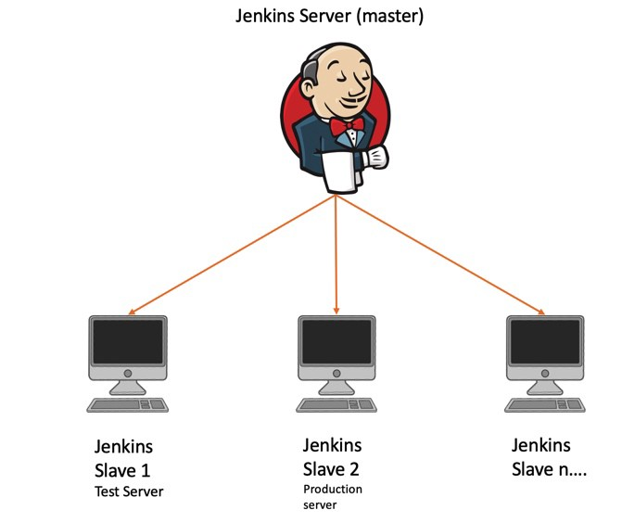

Slide 38
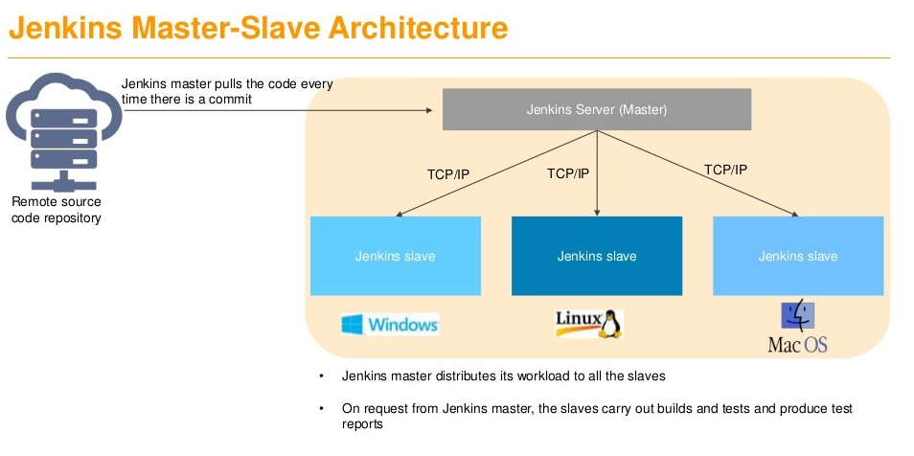
An example in which we use Jenkins for testing in different environments like Ubuntu, MAC, Windows, etc.
The image represents the following functions:
Jenkins checks the Git repository at periodic intervals for any changes made in the source code.
Each builds requires a different testing environment which is not possible for a single Jenkins server. In order to perform testing in different environments, Jenkins uses various Slaves as shown in the diagram.
Jenkins Master requests these Slaves to perform testing and to generate test reports.
How Jenkins Master and Slave Architecture works?

Slide 39
Master and Slave
To add in a ubuntu system first add a node and name it then give a path to home directory /home/msis/jenkins.
In configure global security-> under agents ->ENABLE TCP port for inbound agents and provide a random port no
Then transfer the agent.jar file to the linux system using filezilla
Then use putty to access the ubuntu system to check for the agent.jar file (ls)
Check if java is installed of not (sudo apt-get install openjdk-8-jdk)
[sudo apt-get update] Sudo apt-get install openssh-server - this is for remote access of the ubuntu machine
Firewall block to remove sudo ufw allow portno()
To view rules sudo ufw status [ to enable sudo ufw enable/disable]
Then use the command given in Jenkins node page to run the command in the ubuntu system. (sudo –jar agent.jar -…………………………)
Node Properties - > Add git path in the linux machine (whereis Git) [/usr/bin/git]

Slide 40
Windows Slave
Same like Linux but in node properties add
Git Path -> c:\Program Files\Git\git.exe
MSBUILD path -> c:\Program files(x86)\M VS TOOLS\2017\Build tools\MSBUILD\15.0\bim\MSBUILD.exe
MSTEST path -> c:\Program files(x86)\M VS TOOLS\2019\community\common7\IDE\MSTest.exe

